Slide 1
Assembly (ASM) Presentation
COMP 2825 - Computer Architecture and Organization
Team:
Bryan Campos Leguia
Guilherme Trevisan,
Sami Roudgarian
Notes:
Compiler used:
https://onecompiler.com/assembly
Initial idea, feel free to change it:
Foundation:
What is assembly
General use
Our use (Demo for our program)
Challenges when compiling, why we used an online compiler
Basic structure used in assembly (sections, declaring constants, variables)
Functions:
System Calls
Functions (The stack, Push and Pop)
Our code (Walk through)
How we randomized numbers
How we compared variables
Etc…
Conclusion:
Low level comparison (maybe compare the same code with a python equivalent)
Value in assembly (reverse engineering, optimization.)
How it helped us apply what we covered

Slide 2

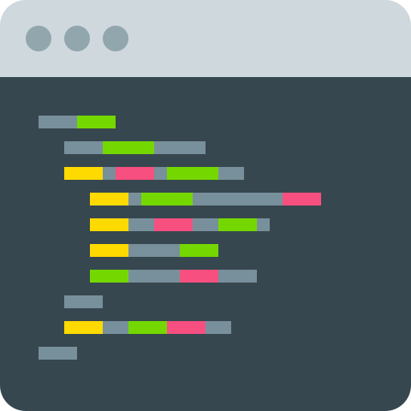

Presentation Outline
About Assembly
General Information / Uses
Famous Examples
The Compiling Process
Our Sample Program
The “Guessing Game” Code
Coding in Assembly
Sections
Basic Syntax
Registers
System Calls
Functions (The Stack)
Conclusion
The importance of assembly
Comparison

Slide 3
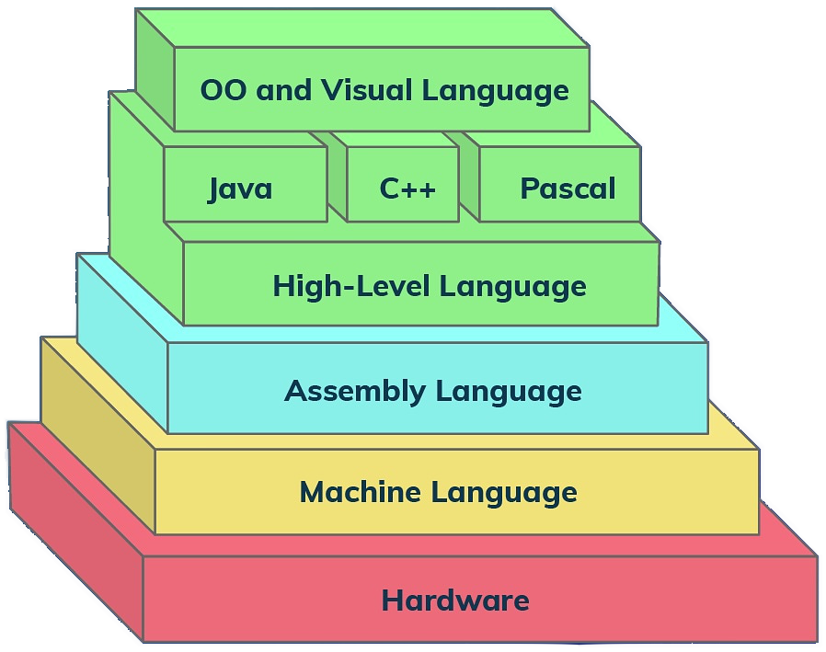
Assembly (ASM)
About: A low-level programming language designed to simplify the instructions fed into a computer’s CPU (A human readable abstraction on top of machine code)
it is also frequently referred to as symbolic machine code. Assembly language is unique each machine. As a result, there are various assembly languages for different machines.
Assembly language allows hardware manipulation, addresses critical performance problems, and gives processor access to specialised instruction.
General Use: Still used today to have better access to bare metal hardware and to address low-level performance issues. (e.g. device drivers)
Suitable to be used in testing, debugging, optimization, and development. works well with devices that have low random access memory. When the source code is not available (reverse engineer software)
Notes:
Moved the reference links here because they will likely not be accessed during the presentation:
About: https://www.techopedia.com/why-is-learning-assembly-language-still-important/7/32268 General Use: https://sectigostore.com/blog/what-is-assembly-language/
Notes:
Basic understanding of Assembly
Why we are covering assembly?
Explain the image of the pyramid
Importance of assembly with optimization, reverse engineering, etc.

Slide 4
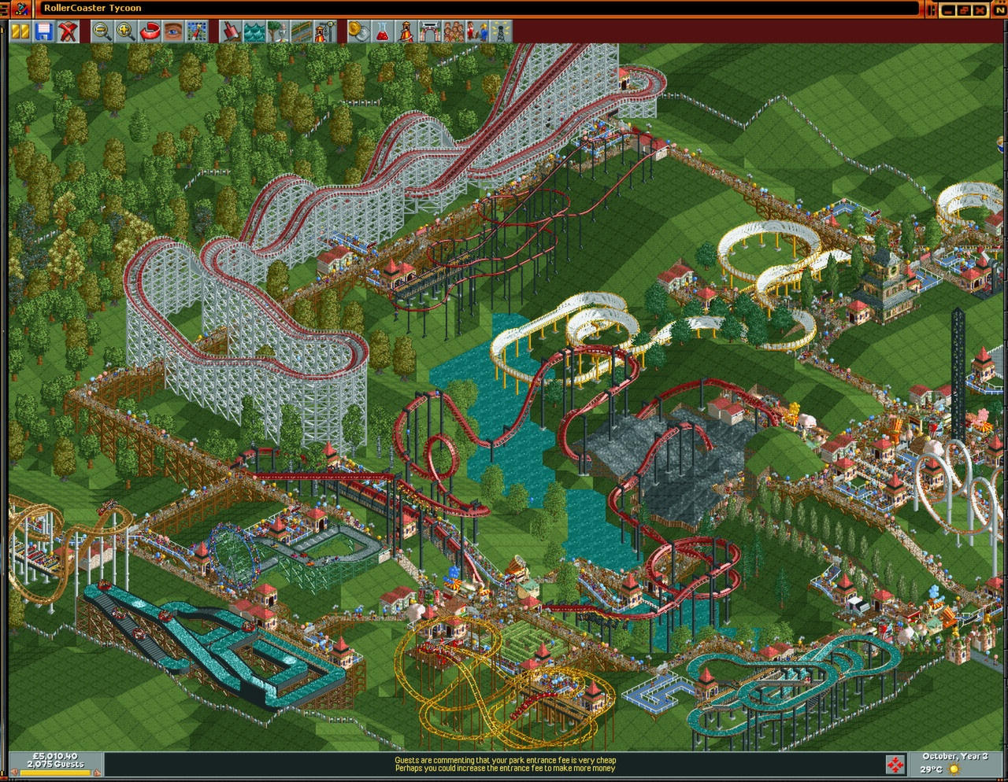
Famous Examples:
RollerCoaster Tycoon: The game was developed by one person who wrote 99% of the code in assembly code for the Microsoft Macro Assembler, with the remaining one percent written in C.
Many NES and Genesis games were also developed using assembly.
Notes:
Not sure if this is important in any way, but I thought it was a fun fact.
Grab more examples about products made in assembly

Slide 5


The Compilation Process
Compile and assemble object file
Connects library and files so they work together
High-level language source
Assembly Source
Object File (Binary)
Executable
Compiler
Assembler
Linker
e.g. “C”
Primarily in binary
Where the program starts, and segments
Ready for OS to run the loader and begin execution
Our code here
Notes:
Reference: https://youtu.be/N2y6csonII4
Links combines object files to create a single executable. (Create points to the correct object files so they can be used everywhere)
Linker explanation
An explanation of the compilation process
Languages interpreted

Slide 6
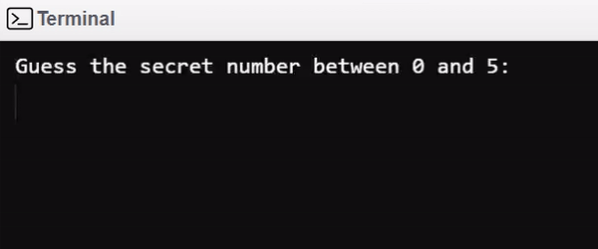
Our Sample Program: Guessing Game
For our demo program we created a simple guessing game. The user is prompted to guess a number that is “randomly” generated from 0 to 5.
Since each assembly language only works on a specific CPU architecture (e.g. ARM for raspberry pi vs x86 for intel chips) we used an online compiler to keep the architecture commands consistent.
x86 compiler used in this project:
https://www.tutorialspoint.com/compile_assembly_online.php
Notes:
X86 Online Compiler: https://www.tutorialspoint.com/compile_assembly_online.php
Brief introduction to the guessing game
Explanation on why we used x86

Slide 7
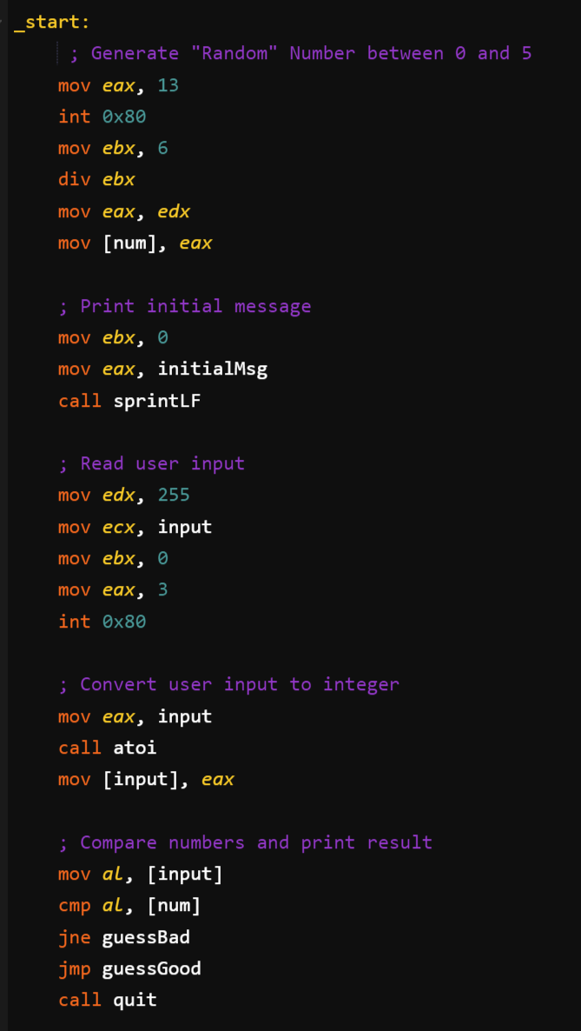
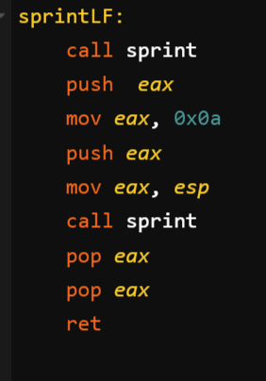
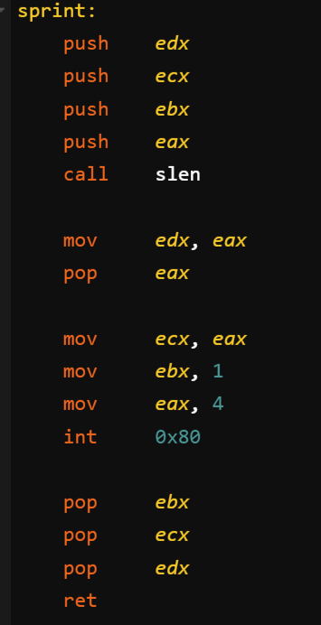
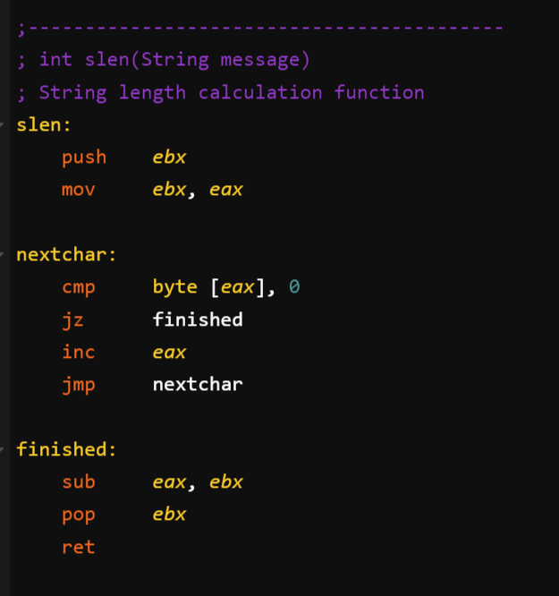
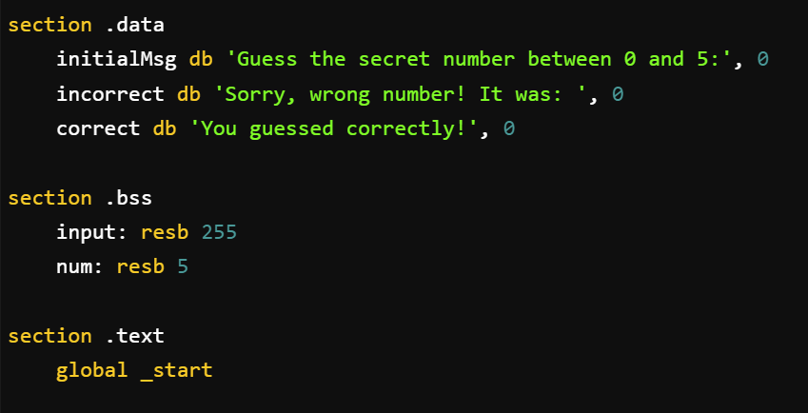
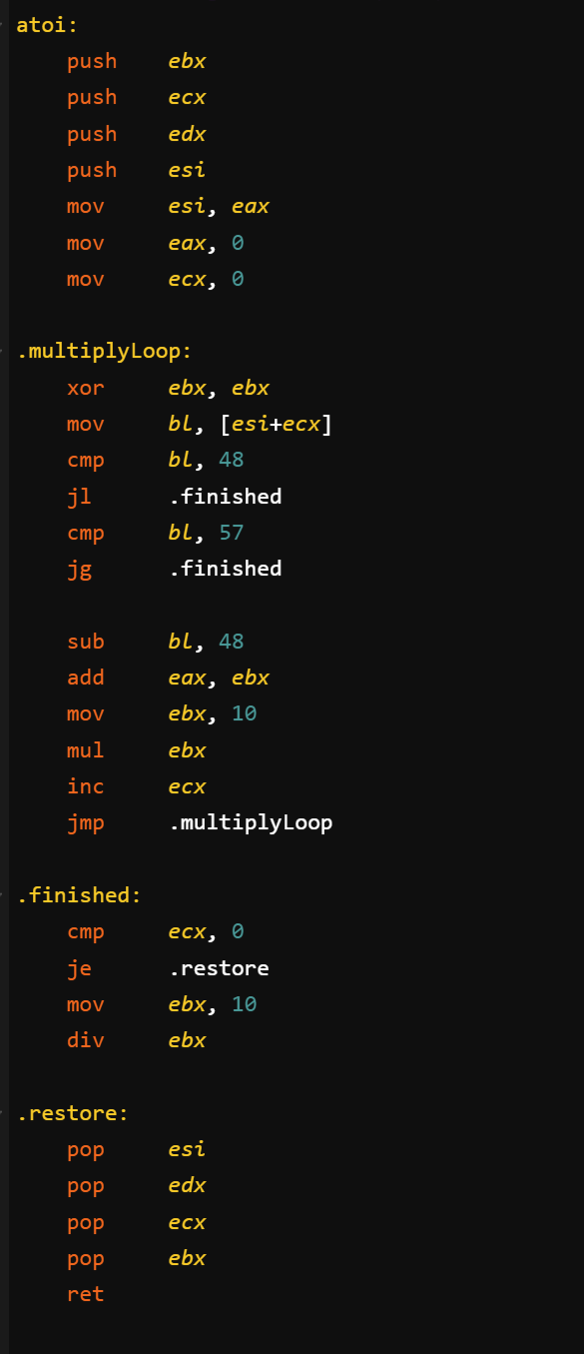
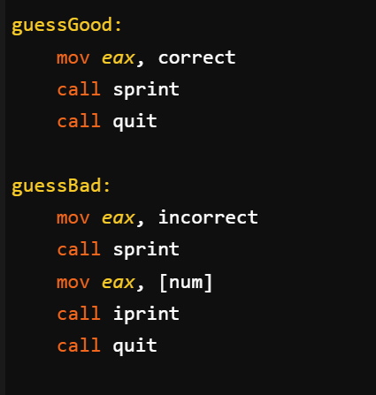
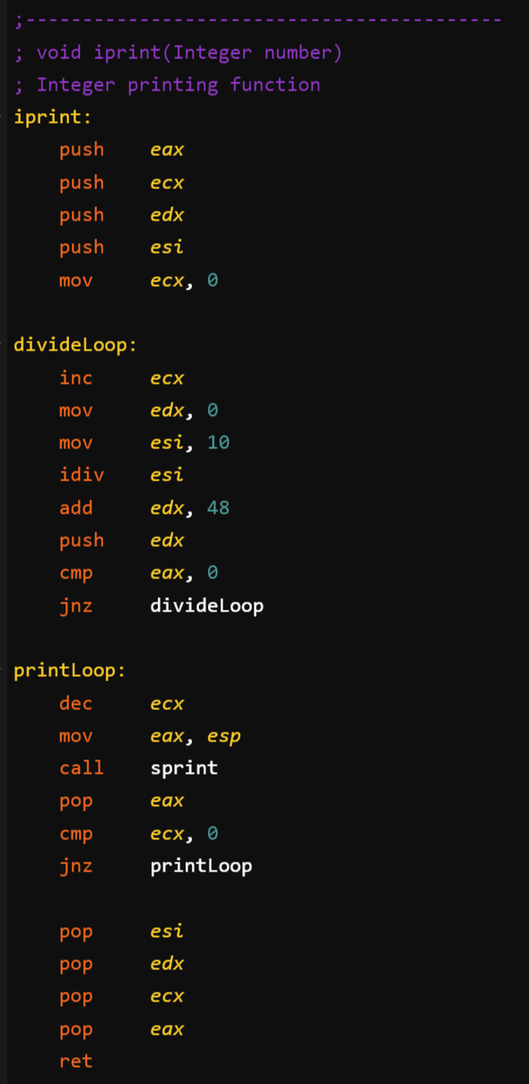
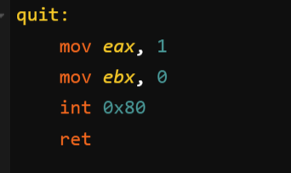
Guessing Game Code
2: _start (main)
String Print (with line feed)
String Print
String Length
1: Sections: Constants/Variables/Text
ASCII to Integer
Success/Failure Messages
Integer Print
Quit Program
Notes:
Go over the code on the left
Maybe go into details about stuff on the right

Slide 8
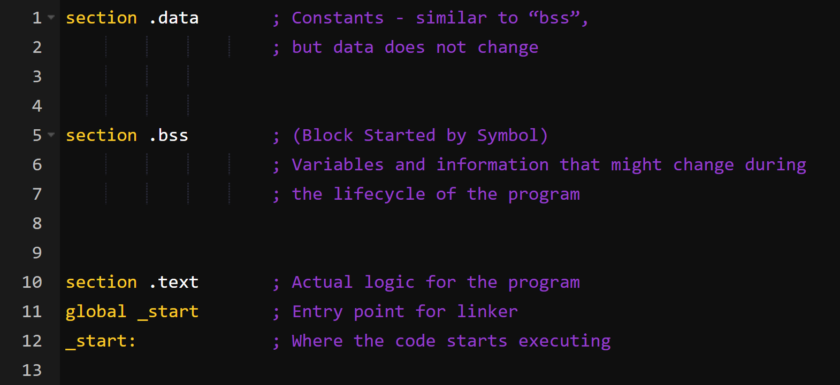
Assembly Sections
Guessing Game
db = Define Byte Number at the end is the null terminator (It doesn’t work when added directly to the string)
e.g. Hex “0x00” Decimal: “0” Chr: NUL Hex: “0xA” Decimal: “10” Chr: “\n” (aka LN)
resb = reserve space for 1 byte We can allocate different types using variations of this: e.g. resw=word, resd=doubleword…
global: directive that marks the symbol as global in the ELF file. Makes it visible to the linker.

Slide 9
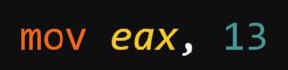
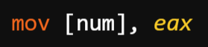
Commands / Basic Syntax
Instruction / Operands e.g. Move the integer “13” to the register “eax”
Instruction <Target>, <Source>
More instructions: sub, add, jmp, je, etc…
[variable] : Square brackets allow you to move data into variables, without them we would read the address.

Slide 10
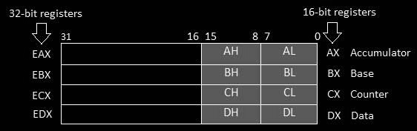
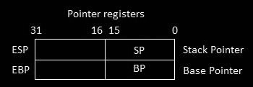
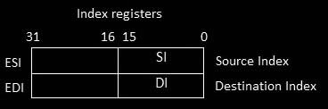
Registers
Data Registers:
“ax” is the primary accumulator; it is used in input/output and most arithmetic instructions.
“bx” is known as the base register, as it could be used in indexed addressing.
“cx” is known as the count register, as the ECX, CX registers store the loop count in iterative operations.
“dx” is known as the data register. It is also used in input/output operations. It is also used with AX register along with DX for multiply and divide operations involving large values.
Other Registers: (For the sake of time, we won’t get into details about each one)
Pointer Registers: IP, SP, BP used to track position in the stack (more about the stack in future slides)
Index Registers: SI, DI source/destination index for string operations.
Control Registers: OF, DF IF, etc… - Many instructions involve comparisons and mathematical calculations.
Segment Registers: specific areas defined in a program for containing data, code and stack
Notes:
Registers: https://www.tutorialspoint.com/assembly_programming/assembly_registers.htm
Registers are a type of computer memory used to quickly accept, store, and transfer data and instructions that are being used immediately by the CPU

Slide 11
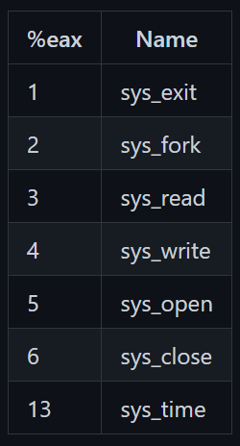
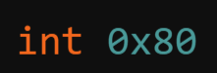
System Calls
System Call Examples:
Example: Getting the time
int (interrupt) + 0x80 = System/Kernel Call
“eax” now has the time stored in it as provided by the system
A more complete list can be found when searching for “Linux System Call Table”
Notes:
Linux System Call Table: https://faculty.nps.edu/cseagle/assembly/sys_call.html

Slide 12
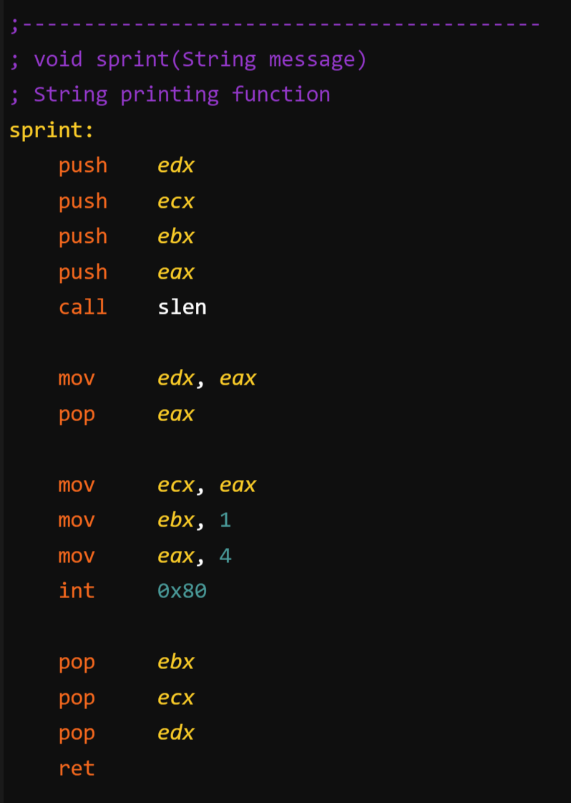


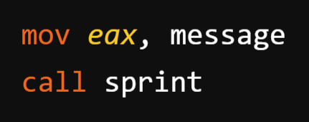
Functions
The Stack: Analogy: A stack of plates Order matters
Preserve “edx”, “ecx”, “ebx” and “eax” by moving them to the stack
Push
Get string length (return value in “eax”)
Move slen value to edx and restore original eax in preparation for system call (that’s why we did it last)
Move string argument from “eax” to “ecx” and setup print system call
Arguments are passed through registers. In this case we move a string constant called “message” to the register “eax” to to be used as argument.
Restore “ebx”, “ecx” and “edx” from the stack (we pushed them earlier)
Pop
Return (“eax” contains our return value)

Slide 13

Conclusion
The process of learning the basics of assembly, helped us understand:
How programs interface with the OS, processor and BIOS.
How the processor access and execute instructions.
How much power we have in higher level languages, and how simplified the commands became on them.
How lower level languages require more commands, but allow for more optimization.
Clarified the importance of what we have been learning about computer architecture and how it relates to logic being converted into hardware.

Slide 14
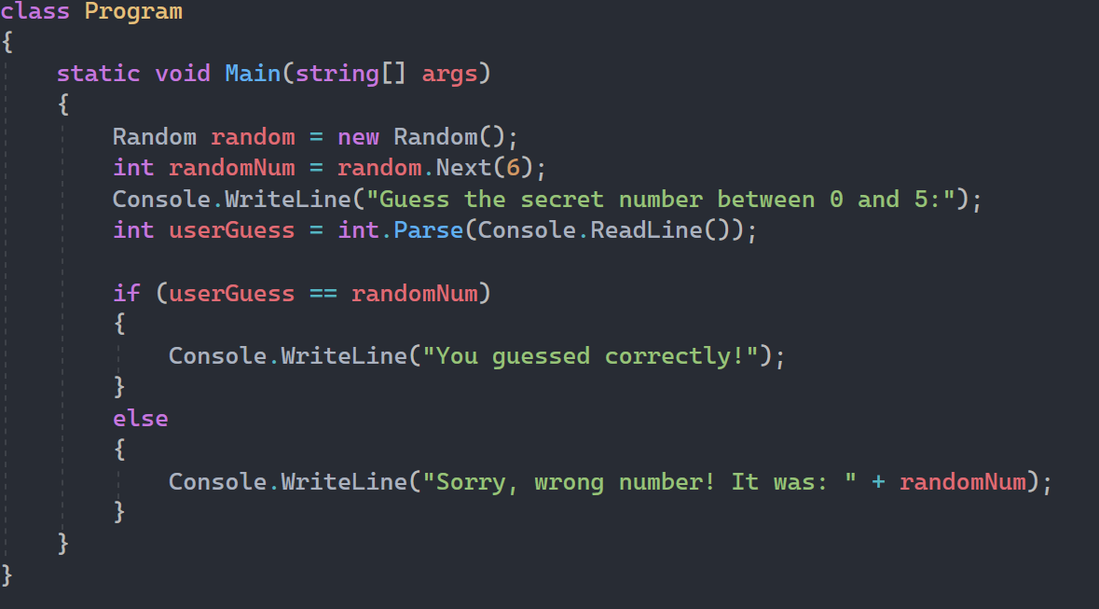
Assembly vs C#
Note: Assembly code is actually much longer, because the functions are omitted.
Notes:
208

Slide 15
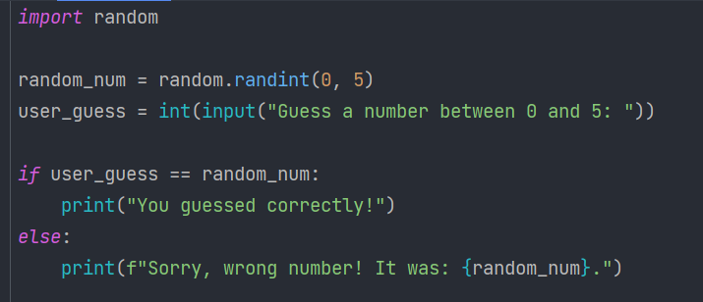
Assembly vs Python
Note: Assembly code is actually much longer, because the functions are omitted.
Notes:
import random
# generate a random number between 0 and 5
random_num = random.randint(0, 5)
user_guess = int(input("Guess a number between 0 and 5: "))
# check if the user guessed the random number correctly and print the result message
if user_guess == random_num:
print("You guessed correctly!")
else:
print(f"Sorry, wrong number! It was: {random_num}.")

Slide 16
References
About: https://www.techopedia.com/why-is-learning-assembly-language-still-important
General Use: https://sectigostore.com/blog/what-is-assembly-language/
X86 Online Compiler: https://www.tutorialspoint.com/compile_assembly_online.php
Linux System Call Table: https://faculty.nps.edu/cseagle/assembly/sys_call.html
The Compilation Process: https://youtu.be/N2y6csonII4
Registers: https://www.tutorialspoint.com/assembly_programming/assembly_registers.htm

